Slide 1
Uninstall in Joomla
Unioffices

Slide 2
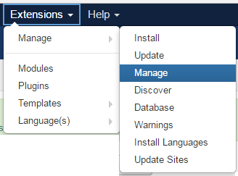
Uninstall in Joomla
If you wish to remove a previous installation on Joomla, first go to the
Extension->Manage->Manage

Slide 3
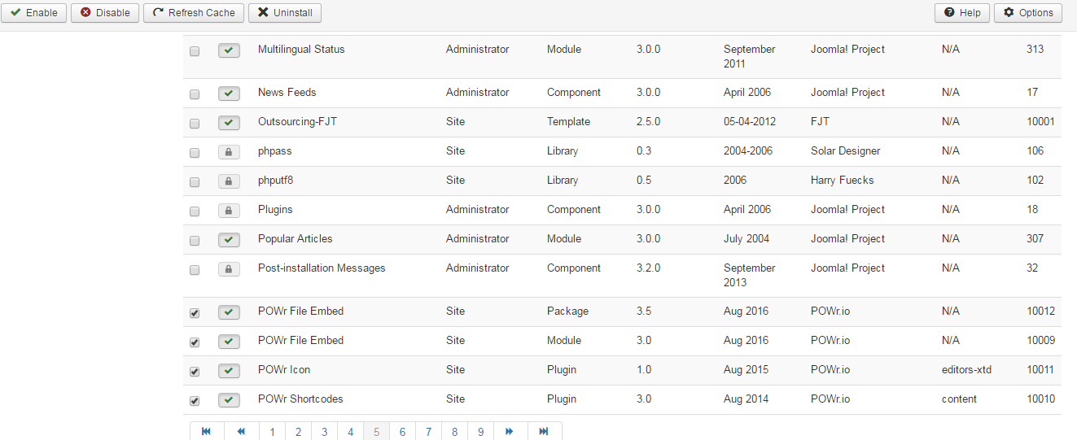
Uninstall in Joomla
Then select your components name from the list.

Slide 4

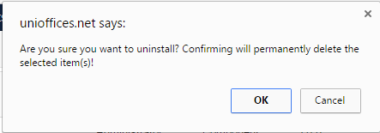
Uninstall in Joomla
Click on the Uninstall button at the top of the list.
A message appears to ask for your permission

Slide 5
Uninstall in Joomla
Continue in removing extension in your Joomla platform. Select and uninstall the extension you wish to remove.

